Slide 1
Sleight of Hand

Slide 2
Mammals

Slide 3
Mammals
Animals with fins

Slide 4
Mammals
Animals with fins

Slide 5
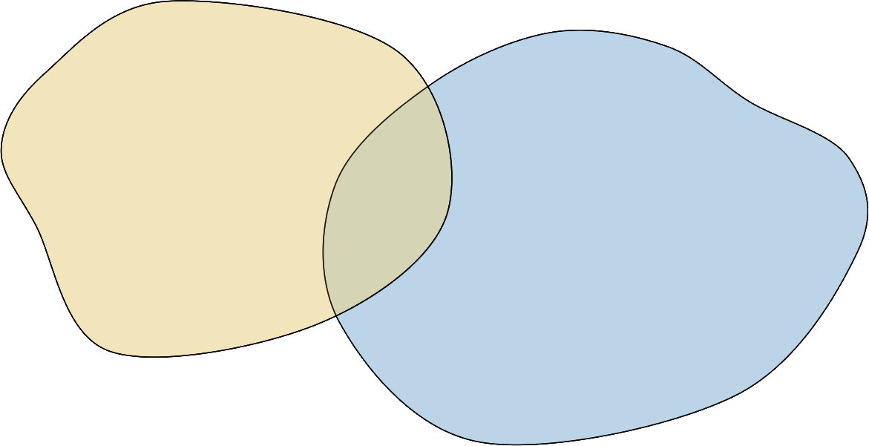
Mammals
Animals with fins

Slide 6
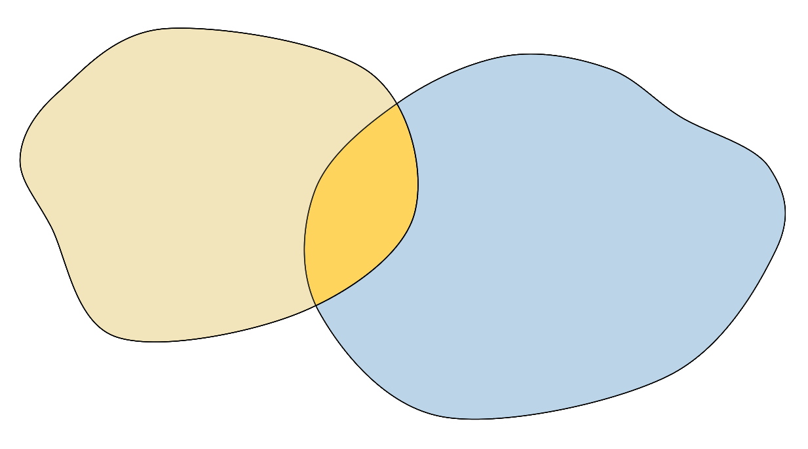

INTERSECTION
Mammals
Animals with fins

Slide 7
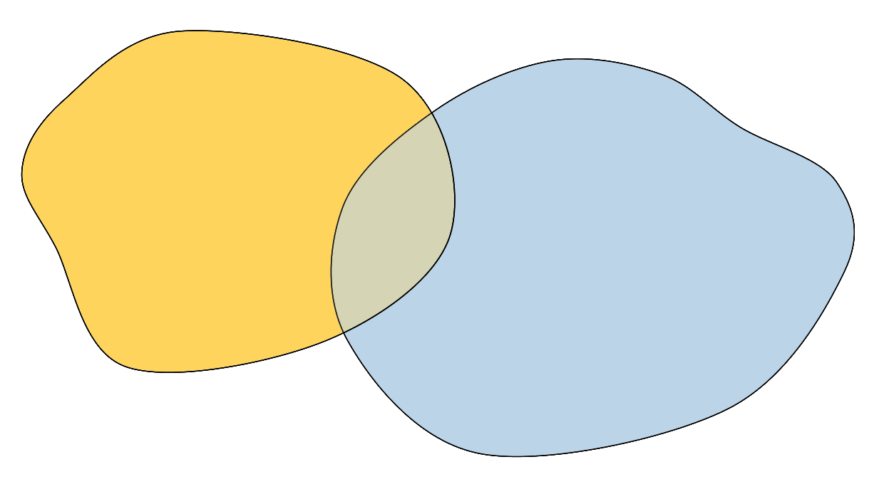

DIFFERENCE
Mammals
Animals with fins

Slide 8
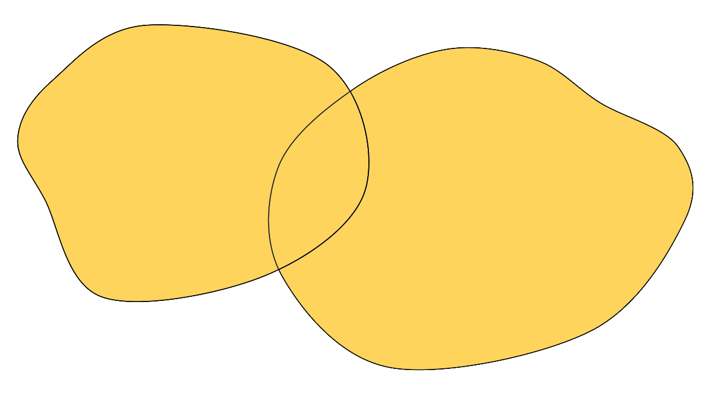
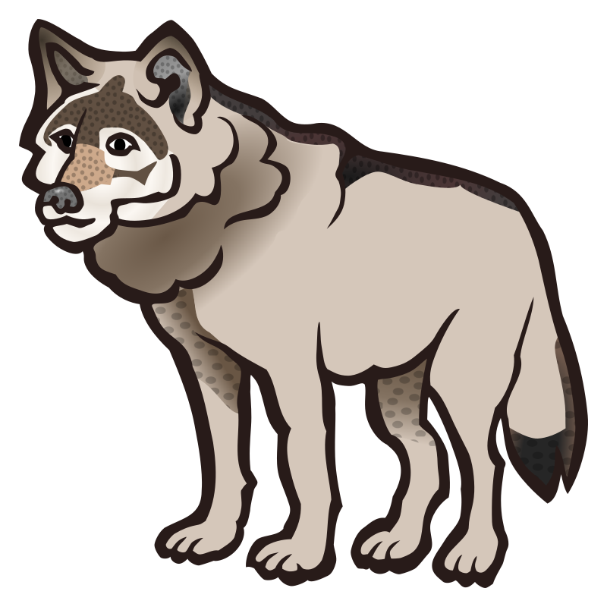
UNION
Mammals
Animals with fins

Slide 9
The Computer Code Sawn in Half

Slide 10
# Read input
n1 = input('Enter numerator: ')
n2 = input('Enter denominator: ')
if n2 != 0:
# Divide
ratio = float(n1) / float(n2)
print('The ratio is {0}'.format(ratio))
else:
print("You can't divide by zero.")

Slide 11
#include <stdio.h>
#include <ctype.h>
#include <string.h>
#define INPUT_LEN 200
reverse.c
int main() {
char input[INPUT_LEN];
int len;
printf("Enter a word: ");
fgets(input, INPUT_LEN, stdin);

Slide 12
#include <stdio.h>
#include <ctype.h>
#include <string.h>
#define INPUT_LEN 200
int main() {
char input[INPUT_LEN];
int len;
printf("Enter a word: ");
reverse.c
fgets(input, INPUT_LEN, stdin);

Slide 13
fgets(input, INPUT_LEN, stdin);
reverse.c
len = strlen(input);
while (len && isspace(input[len - 1])) {
len--;
}
while (len > 0) {
putchar(input[len - 1]);
len--;
}
putchar('\n');
return 0;
}

Slide 14
The Vanishing Slides

Slide 15
Commedia dell'arte
Pulcinella is a cheeky servant from the countryside, cunning and greedy.
A cowardly braggart, Capitano is a loner and a parody of the professional soldier.
Arlecchino is a comical servant, stupid with flashes of wit, credulous and lazy, whose schemes always fail.
Pantalone is a mean and miserly old man, credulous, dissolute, fussy, jealous of his young wife.
Columbina is a perky maid from a small city, witty and impertinent, given to intrigue.

Slide 16
Commedia dell'arte
Pulcinella cunning servant.
Capitano cowardly braggart.
Arlecchino comical servant.
Pantalone dissolute and miserly old man.
Colombina impertinent maid.

Slide 17
Commedia dell'arte
Pulcinella cunning servant.
Capitano cowardly braggart.
Arlecchino comical servant.
Pantalone dissolute and miserly old man.
Colombina impertinent maid.

Slide 18
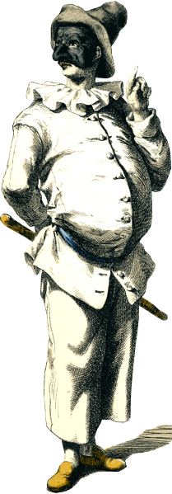
Pulcinella cunning servant.
Commedia dell 'arte

Slide 19
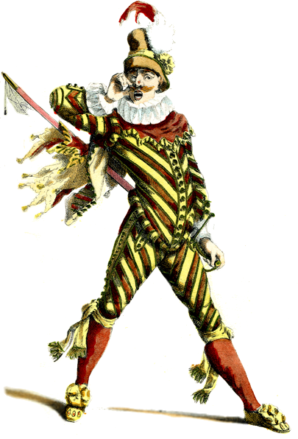
Pulcinella cunning servant.
Capitano cowardly braggart.
Commedia dell 'arte

Slide 20
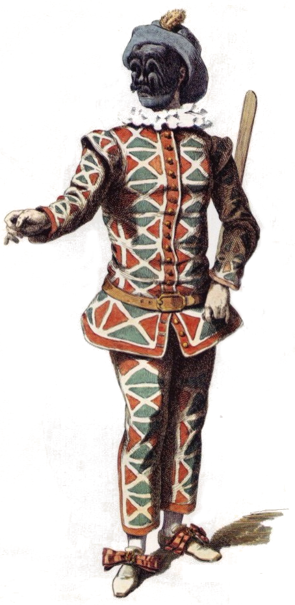
Pulcinella cunning servant.
Capitano cowardly braggart.
Arlecchino comical servant.
Commedia dell 'arte

Slide 21
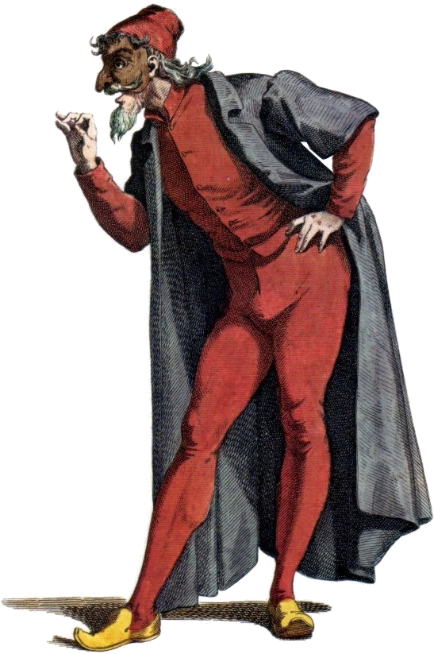
Pulcinella cunning servant.
Capitano cowardly braggart.
Arlecchino comical servant.
Pantalone dissolute and miserly old man.
Commedia dell 'arte

Slide 22
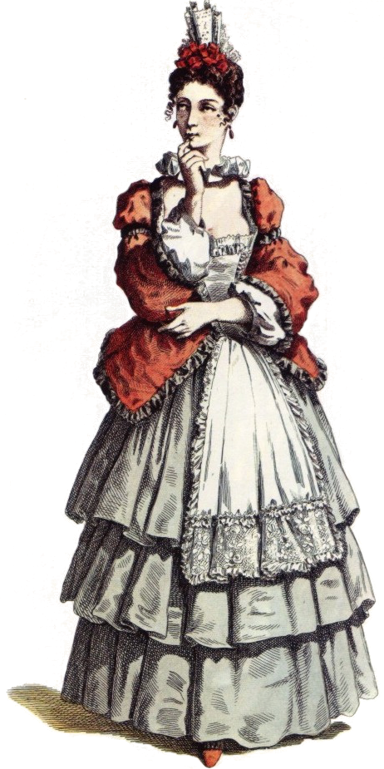
Pulcinella cunning servant.
Capitano cowardly braggart.
Arlecchino comical servant.
Pantalone dissolute and miserly old man.
Colombina impertinent maid.
Commedia dell 'arte

Slide 23
Commedia dell 'arte
Pulcinella cunning servant.

Slide 24
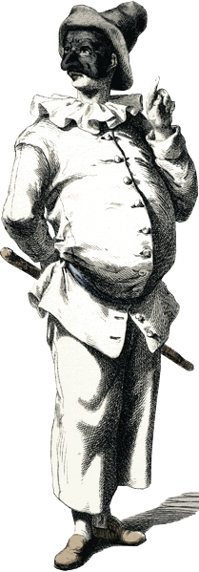
Commedia dell 'arte
Capitano cowardly braggart.

Slide 25
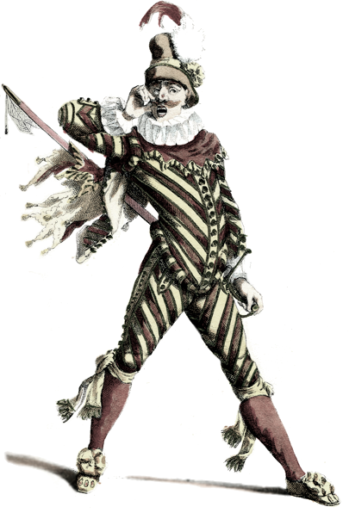
Commedia dell 'arte
Arlecchino comical servant.

Slide 26
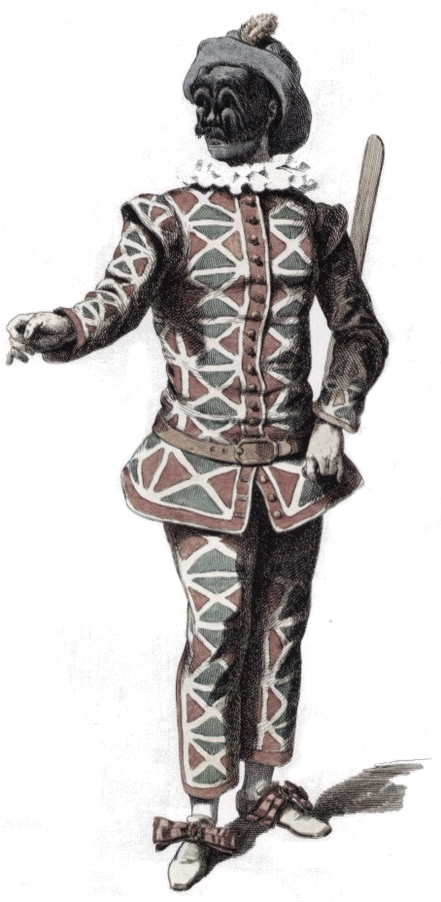
Commedia dell 'arte
Pantalone dissolute and miserly old man.

Slide 27
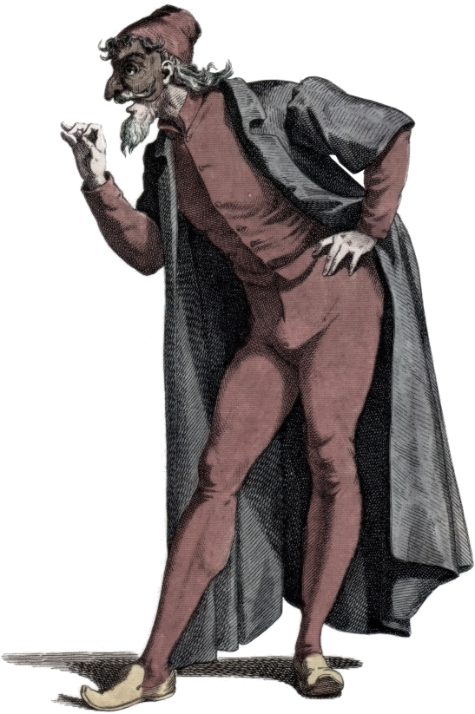
Commedia dell 'arte
Colombina impertinent maid.

Slide 28
Commedia dell 'arte
Pulcinella cunning servant.

Slide 29
Commedia dell 'arte
Capitano cowardly braggart.

Slide 30
Commedia dell 'arte
Capitano cowardly braggart.

Slide 31
Commedia dell 'arte
Arlecchino comical servant.

Slide 32
Commedia dell 'arte
Arlecchino comical servant.

Slide 33
Commedia dell 'arte
Pantalone dissolute and miserly old man.

Slide 34
Commedia dell 'arte
Pantalone dissolute and miserly old man.

Slide 35
Commedia dell 'arte
Colombina impertinent maid.

Slide 36
Commedia dell 'arte
Colombina impertinent maid.

